Slide 1

Front End Engineering-II
Project Report
Semester-III (Batch-2023) Gaming Mania
Supervised By: Submitted By:
Thirupathy M Aman Kumar (2310991770)
Anshul Phondni (2310991781)
Ashpreet Singh (2310991799)
Bhupesh Yadav (2310991807)
Department of Computer Science and Engineering
Chitkara University Institute of Engineering & Technology,
Chitkara University, Punjab

Slide 2
Abstract
Gaming Mania: Enhancing Memory is an interactive web-based platform offering a variety of cognitive games designed to boost memory, concentration, and problem-solving skills. The platform features an array of games, including Memory Card Game, Tic Tac Toe, Simon Says, Tower Block, Scramble Word, Brick Breaker, Memory Matrix, and Arrange Number. Each game is crafted to provide a fun yet challenging experience that adapts to different skill levels, making it suitable for users of all ages.

Slide 3
Table of Contents
Introduction
Problem Definition
Requirements
Modules
Results
Conclusions

Slide 4
Introduction
Background:
Provides context and setting for the project.
Explains why the project is relevant and how it fits into the larger picture.
Objectives:
Specific goals the project aims to achieve.
Outlines what the project intends to accomplish and how success will be measured.
Significance:
The importance and impact of the project.
Highlights the value and benefits of the project, and why it matters

Slide 5
Introduction: Background
Project Overview:
“Gaming Mania: Enhancing Memory” is a platform offering various memory-enhancing games.
Aims to combine entertainment with cognitive benefits.
Need:
Growing demand for engaging, brain-stimulating games.
Designed for users seeking both fun and mental challenge.

Slide 6
Introduction: Objectives
Primary Goal: To develop a web-based platform featuring a diverse set of games that challenge and enhance users’ cognitive abilities.
User Experience: To create an intuitive, responsive, and ad-free environment where users can easily navigate between different games and select appropriate difficulty levels.
Target Audience: Cater to a wide range of users, including children, students, and adults, by offering games that are both fun and beneficial for cognitive development.

Slide 7
Introduction: Significance
Educational Value: Emphasize the educational benefits of the games, particularly how they help improve memory, focus, and strategic thinking.
Entertainment Factor: Discuss the importance of making learning fun through interactive gameplay, ensuring that users are not only benefiting cognitively but also enjoying the experience.
Wider Impact: Explain how Gaming Mania can be used as a tool for both personal cognitive enhancement and as an educational resource in schools or at home.

Slide 8
Problem Statement
There is a need for an ad-free, user-friendly online platform that offers a variety of cognitive games designed to enhance memory, concentration, and problem-solving skills. Many existing platforms are cluttered with ads, lack game variety, or do not provide a seamless experience across devices. Gaming Mania addresses this by offering a diverse collection of engaging and educational games within a single, easy-to-navigate website, ensuring an enjoyable and uninterrupted user experience for all ages.

Slide 9
Requirements: Software
Front-end: HTML, CSS and JavaScript.
Back-end: Node.js and python.
Image Editing Software
Code Editor

Slide 10
Requirements: Hardware
Devices: Desktop, laptop, tablet, or smartphone with a modern web browser.
Internet: Stable internet connection for smooth gameplay.
Display: Minimum screen resolution of 1024x768 pixels.
Input: Keyboard and mouse (for desktops/laptops) or touchscreen (for mobile devices

Slide 11
Modules
Home Page: Central hub with navigation options and a play games button.
Game Selection Page: Allows users to choose a game to play.
Level Selection Page: Enables users to select difficulty levels for games.
Game Pages: Individual pages for each game with specific features.

Slide 12
Modules: Home Page
Navigation Bar: Positioned at the top with links to Feedback, Login, About Us, and Sign-Up pages for easy access.
Play Games Button: Central, prominent button that directs users to the Game Selection Page.
Animations: Engaging visual effects and animations to enhance user experience and draw attention.

Slide 13
Modules: Game Selection Page
Game Options: Showcases various games with eye-catching icons representing each game.
Clickable Icons: Users can click on game icons to navigate to the respective game pages.
User-Friendly Design: Simple and intuitive layout for easy game selection and navigation

Slide 14
Modules: Level Selection Page
Difficulty Levels: Provides options for easy, medium, or hard levels depending on the selected game.
User Choice: Users select the desired difficulty level before starting the game.
Smooth Navigation: Redirects users to the appropriate game level page with minimal clicks.

Slide 15
Results
User Engagement: Increased interaction with various memory-enhancing games.
Performance Metrics: Data collected on user performance, including scores and time taken.
Feedback Analysis: Insights gained from user feedback on gameplay and usability.
Visuals: Screenshots and graphs depicting key metrics and user experiences.

Slide 16
Results: User Engagement
Game Popularity: Data on which games were most played, including the number of plays for each game.
Session Duration: Average time users spend on the platform per session, reflecting user engagement and interest.
Activity Metrics: Metrics such as the average number of games played per user and how often users return to the site

Slide 17
Results: Performance Metrics
Move Counts and Timers: Analysis of average moves and time taken to complete games, especially for the Memory Card Game. Includes comparisons between easy, medium, and hard levels.
High Scores: Display of top scores achieved across different games and the distribution of these scores among users.
Difficulty Levels: Insights into user performance at various difficulty levels, identifying which levels are most challenging or easiest

Slide 18
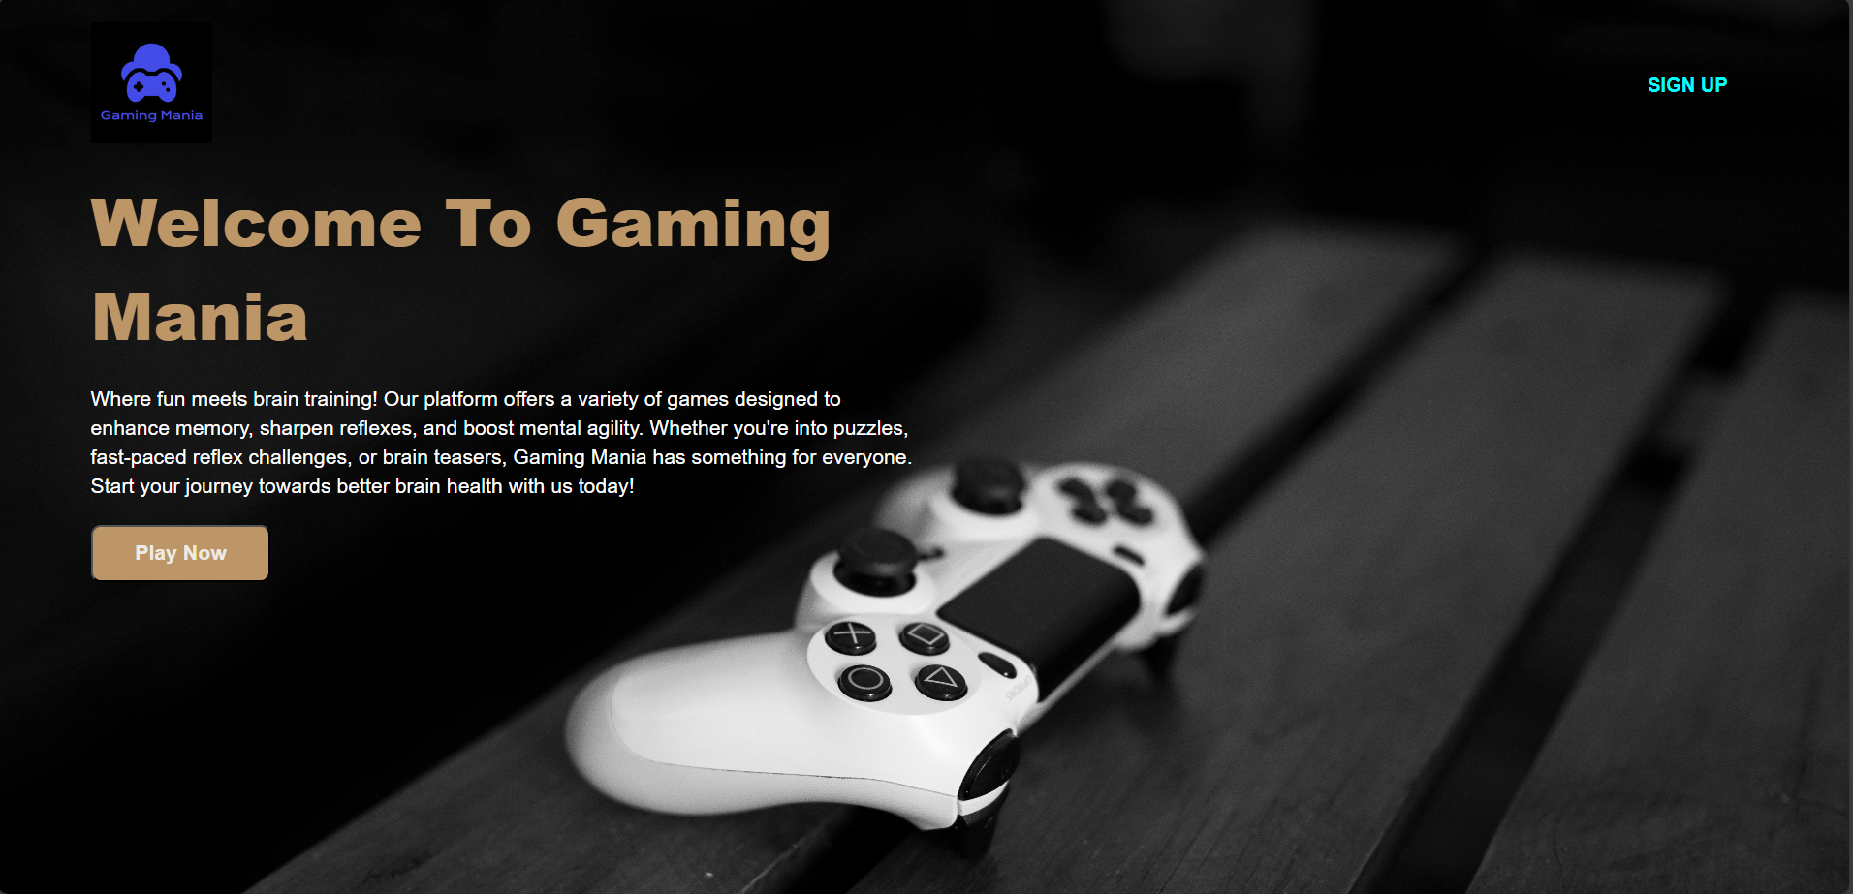
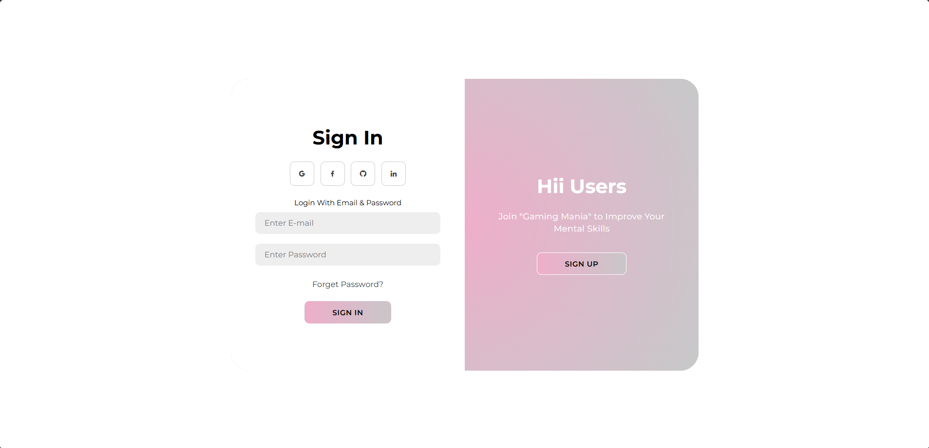
Results: Visual Results
Home Page
Sign In Page

Slide 19
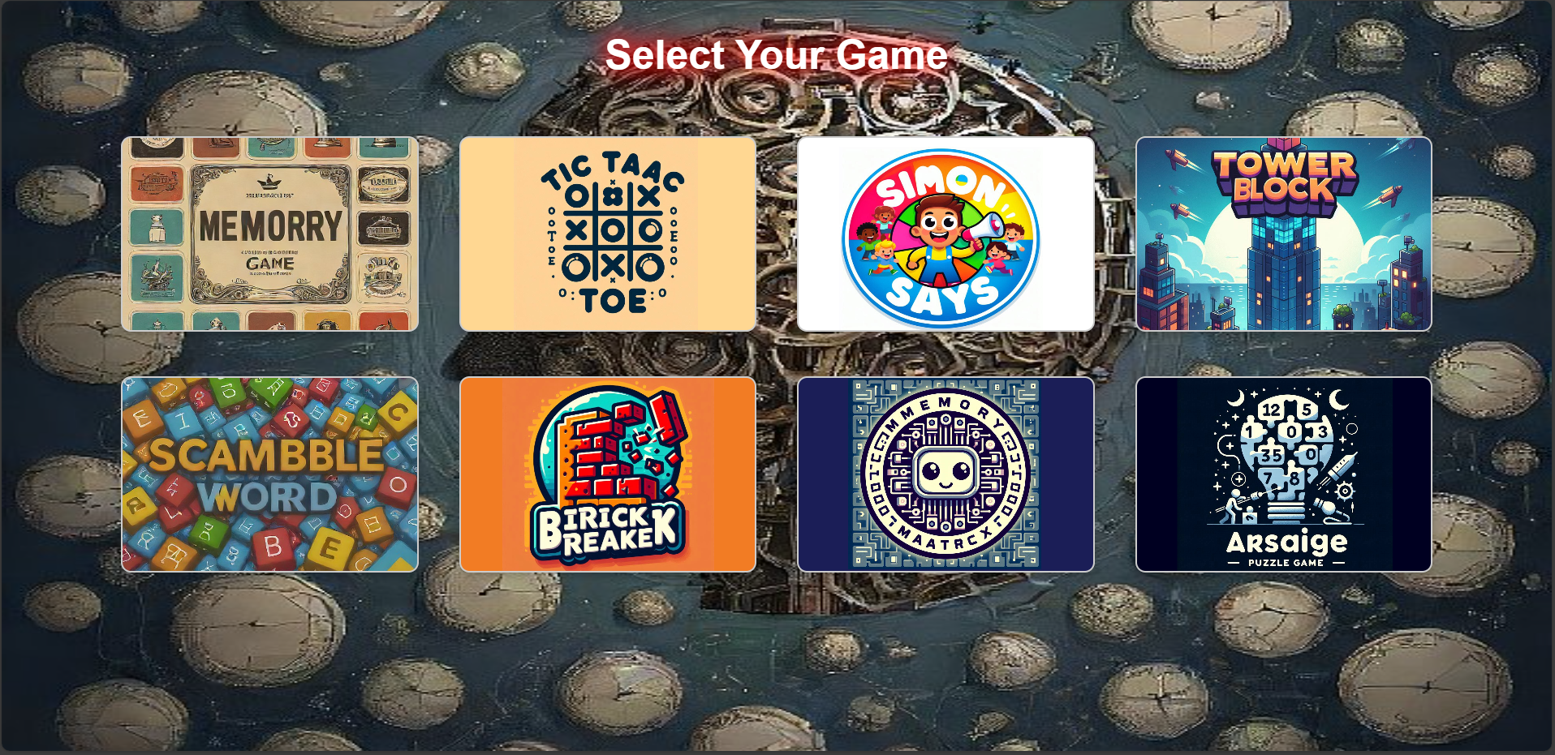
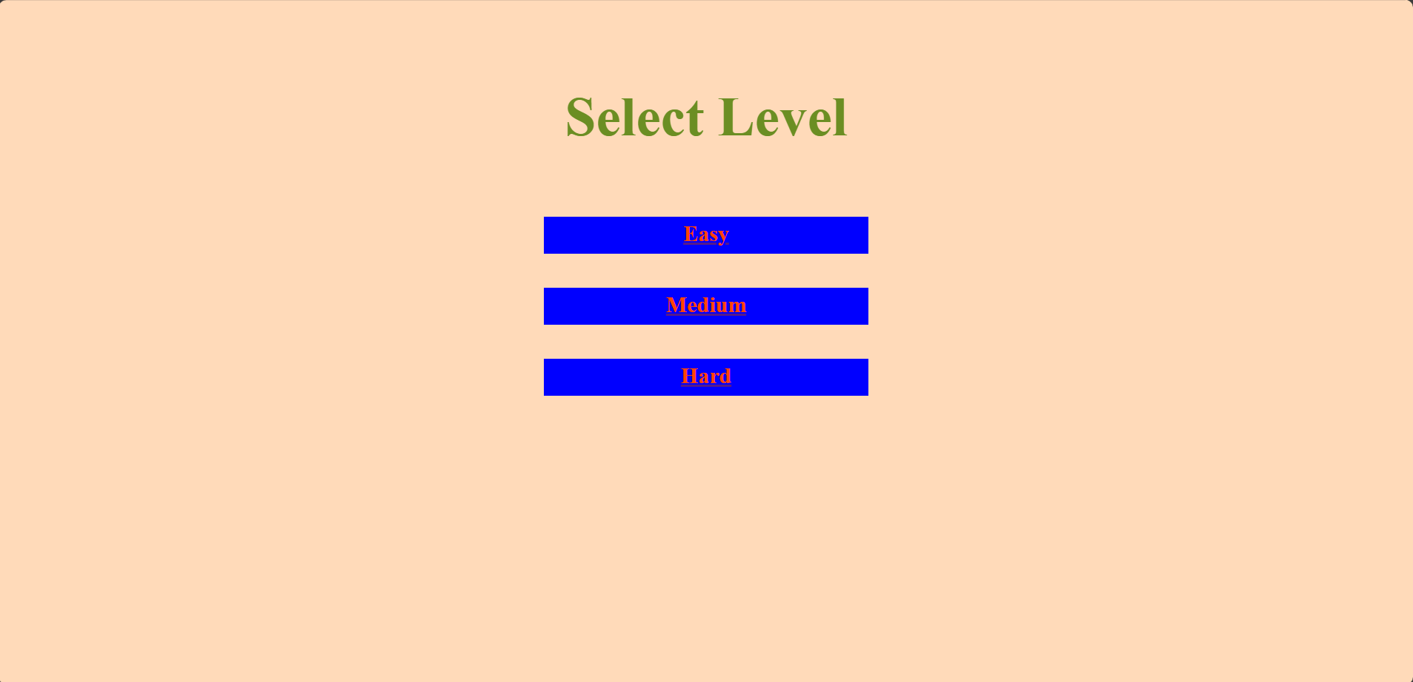
Results: Visual Results
Select Game Page
Select Level for Memory Card Game Page

Slide 20
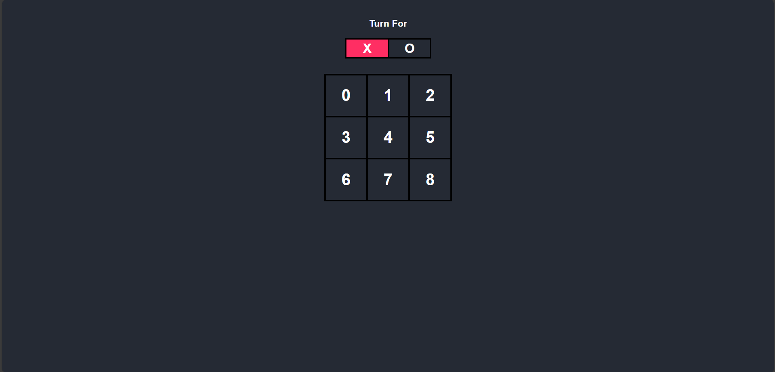
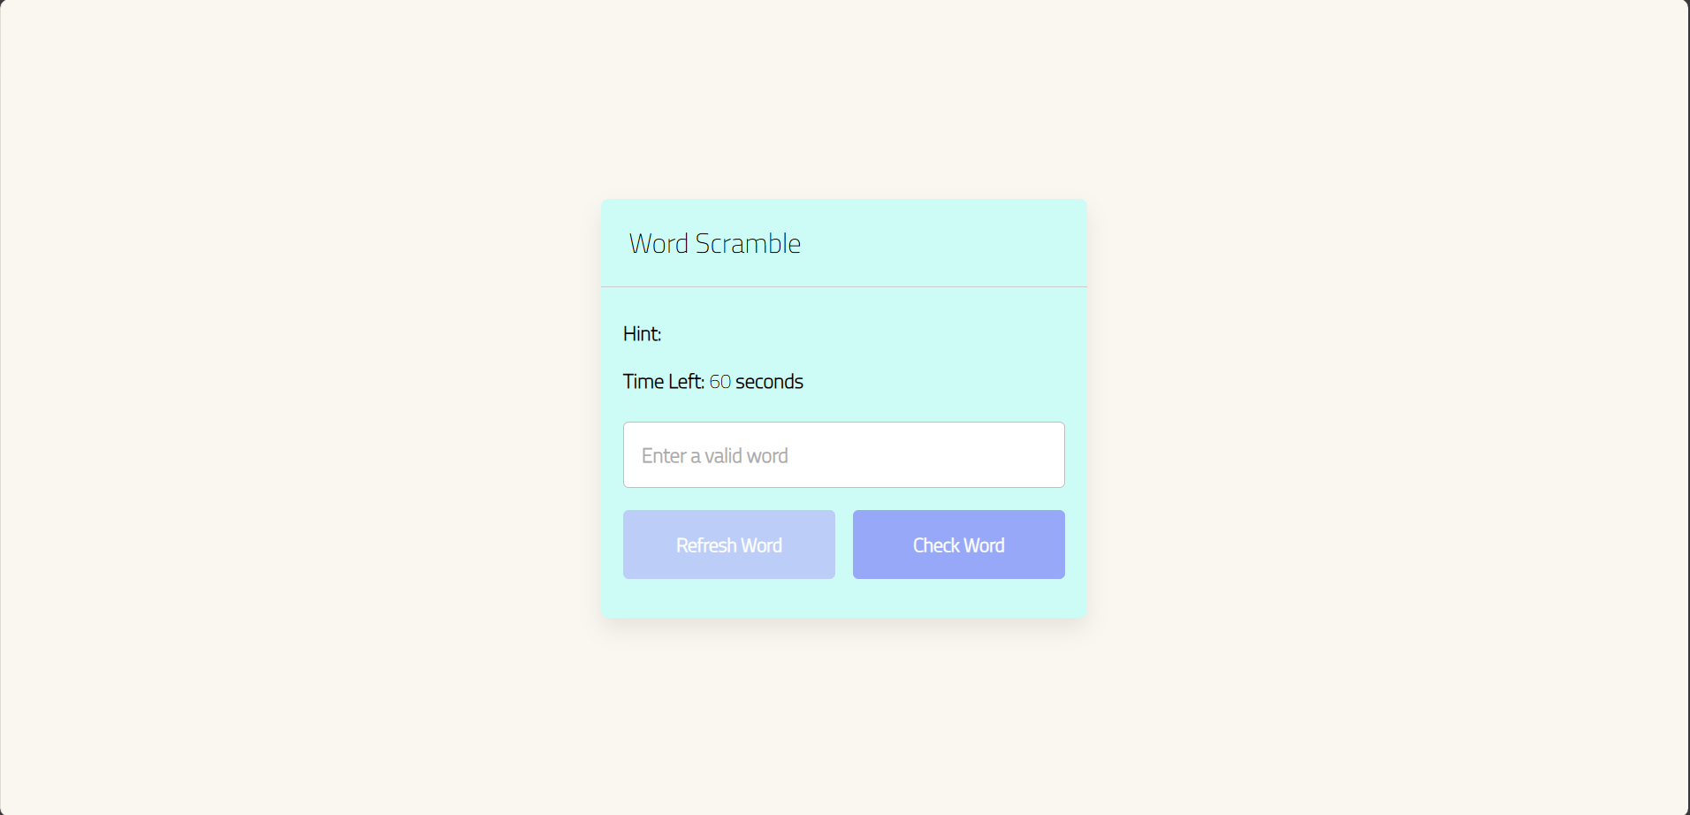
Results: Visual Results
Tic Tac Toe Game Page
Scramble Word Game Page

Slide 21
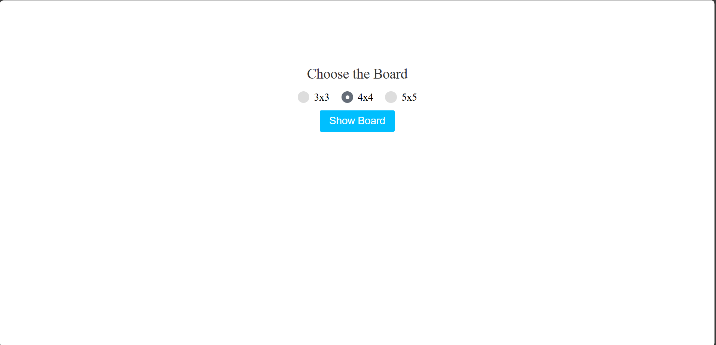
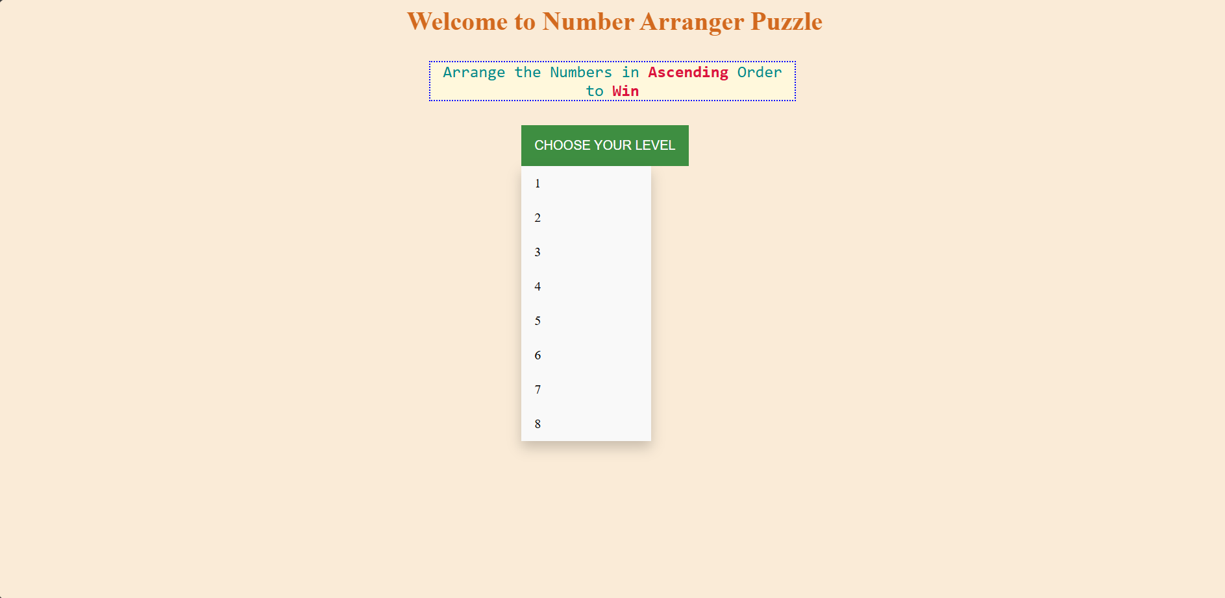
Results: Visual Results
Select Board for Memory Matrix Game Page
Select Level for Arrange Puzzle Game Page

Slide 22
Conclusions
Development of Cognitive Skills: Successfully created a series of games targeting memory and reflex improvement, providing an interactive and enjoyable way for users to engage with cognitive training.
Responsive Web Design: Implemented a fully responsive design, ensuring that "Gaming Mania" is accessible and functional across various devices, from desktops to smartphones.
Future Work: Explore potential enhancements, like adding more game types, incorporating multiplayer modes, or using AI to adjust game difficulty dynamically.

Slide 23


